Slide 1
Predictive Data Mining – basketball playoffs qualification
André Sousa up
Pedro Fonseca up
Tomás Maciel up
AC – Machine Learning 2023/2024

Slide 2
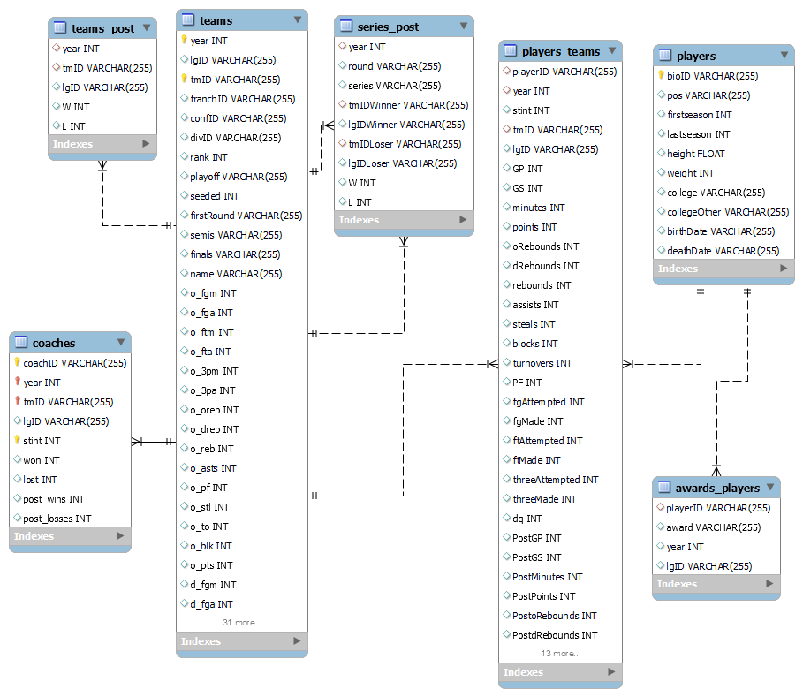
Domain description
For 10 seasons (years) data from players, teams, coaches, games and several other metrics were gathered and arranged on this dataset.
Our main goal is, using this data, to develop a model that can predict which teams go to the playoffs on the next season (8 first teams).

Slide 3
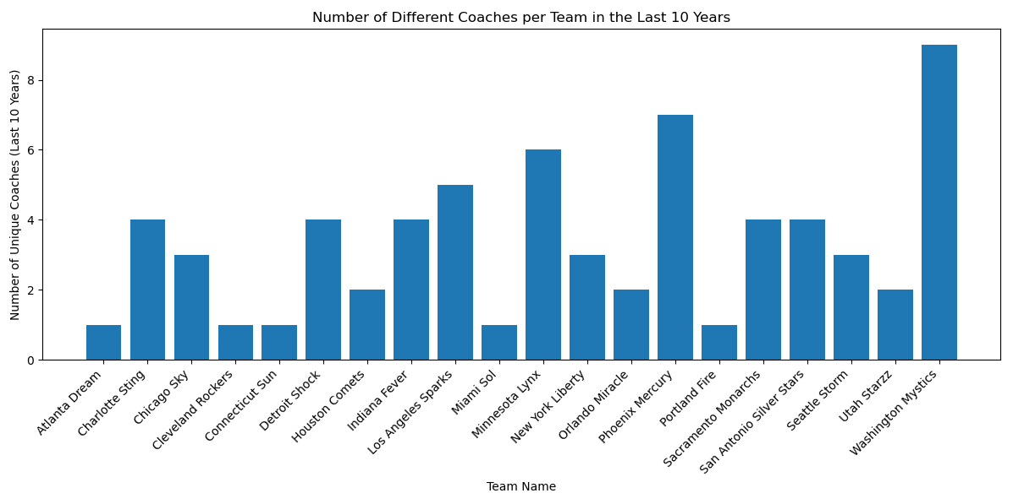
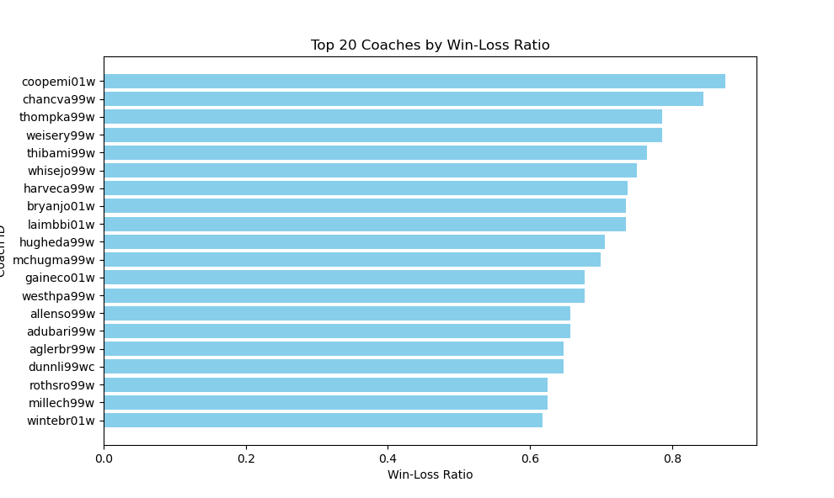
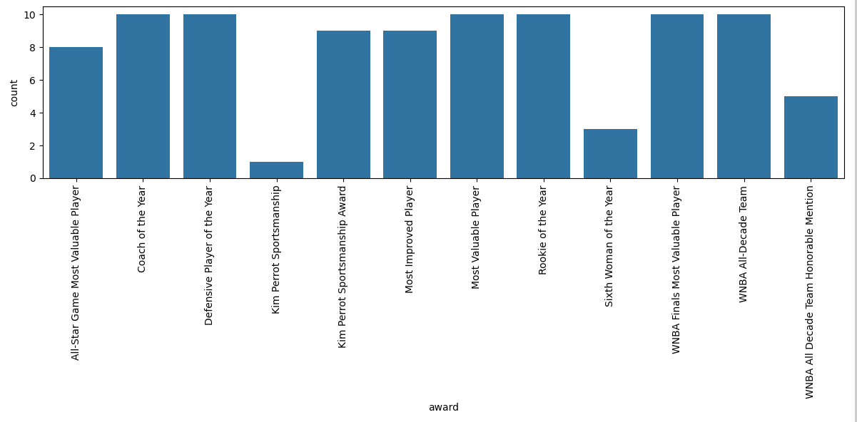
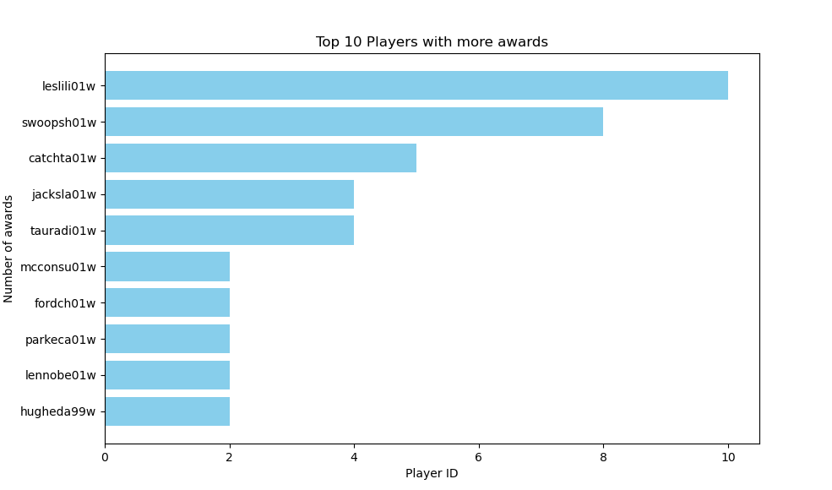
Exploratory Data Analysis
1
1- There are teams with diferente managers on the 10 years, however a few kept the same manager.
2- The 20 coaches with the higher Win-Loss Ratio.
3 – The top 10 players with more awards won, that suggests us the best players.
4 – The number of awards given to players.
2
3
4

Slide 4
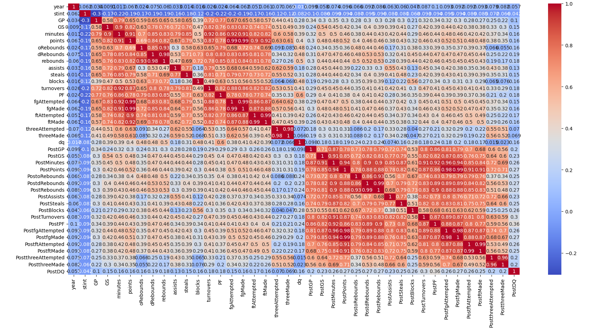
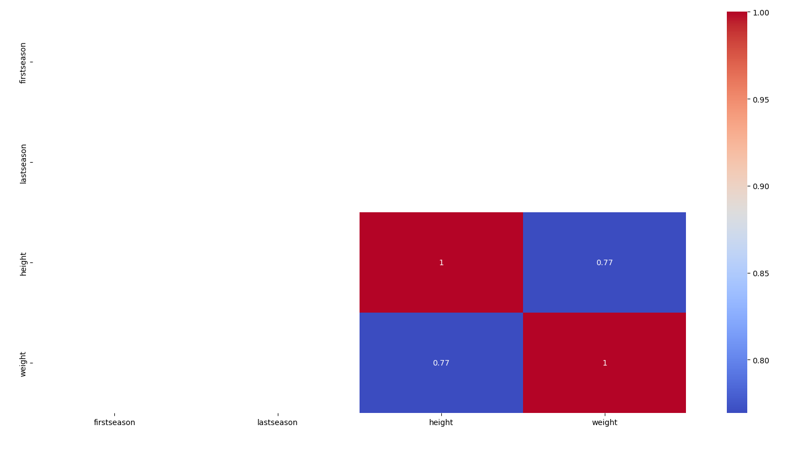
Exploratory Data Analysis
7
Team | Playoff Appearances
0 LAS | 9
1 SAC | 8
2 DET | 7
3 NYK | 7
4 SEA | 7
5 CON | 6
6 HOU | 6
7 IND | 6
8 WAS | 5
9 SAS | 3
10 CLE | 3
11 CHA | 3
12 PHO | 3
13 UTA | 2
14 MIN | 2
15 ORL | 1
16 MIA | 1
17 ATL | 1
5
5 - Correlation matrix of players_teams, which allows to see that many individual stats are correlated.
6 - Correlation matrix, that show us the high correlation between weight and height.
7 – Playoff appearances per team, that show us the teams that are statistically more predictable to advance to playoffs again..
8 - Playoff Wins per team that shows us the last winners of the playoffs.
6
8
Team | PlayOff Wins
0 DET | 3
1 LAS | 2
2 PHO | 2
3 HOU | 1
4 SEA | 1
5 SAC | 1

Slide 5
Problem Definition
Our goal in this project is to predict whether a team does or does not qualify to the playoffs (which means finishes or not in top 8).
Our problem is a classification problem where the output variable that we are predicting is ‘Y’ (team qualified to playoffs) or ‘N’ (team didn’t qualify to playoffs).

Slide 6
Data preparation
Drop of irrelevante features on players table (deathDate, NaN pos, firstSeason, lastSeason)
Drop players whose birthDate = 0000-00-00
Mapping colleges to indexes and positions to indexes also on players table
Update birthDate to birthYear (day and month are irrelevante for our goal)
Merge table awards with players, and then add a new atribute awards_count for each player
Feature Engineering for players_teams table (Creation of ‘EFF’, ‘DPR’, ‘FG_Percentage,’ ‘FT_Percentage’ and ‘PPG’ and drop the rows with null values of 'FG_Percentage', 'FT_Percentage', 'PPG’
Merge players_teams with players by playerID (it’s the same as bioID presente on players)
Drop lgIDLoser and lgIDWinner (not relevant) in series_post and update of ‘W’ and ‘L’ to percentages
Creation of new columns of table coaches (‘WLRatio’ and ‘WLRatio_Post’)

Slide 7
Data preparation
Feature Engineering related to score on table teams (creation of ‘PredictedTeamScore’ and ‘RealTeamScore’)
More feature Engineering on table teams (‘progress’, ‘offensive_performance’ and ‘defensive_performance’, …)
Merge of tables coaches and teams
Mapping of playoff (in table teams) to boolean values (‘Y’=1 and ‘N’=0)
Creation of lagged features that will be used on the models, named on tables players_teams and teams

Slide 8
Experimental Setup

Slide 9
Results

Slide 10
Results

Slide 11
Conclusions

